Slide 1



SUSTAINABLE ENERGY SOLUTIONS: PREDICTING RESIDENTIAL ELECTRICITY CONSUMPTION USING DEEP LEARNING TECHNIQUES
PROJECT BATCH: B3
PROJECT GUIDE:
Guided by : Mr. K. PURUSHOTAM NAIDU
Associate Professor., Department of
CSE-AIML, GVPCEW
PROJECT MEMBERS:
M. Esha Thaniya (21JG1A4227)
T. Durga Prasanna (21JG1A4257)
P. Susmitha (21JG1A4244)
N. Jayavardhini (20JG1A4233)
Department of Computer Science and Engineering
GAYATRI VIDYA PARISHAD COLLEGE OF ENGINEERING FOR WOMEN
[Approved by AICTE NEW DELHI, Affiliated to JNTUK Kakinada]
[Accredited by National Board of Accreditation(NBA) for B.Tech. CSE, ECE & IT – valid from 2019-22 and 2022-25]
[Accredited by National Assessment and Accreditation Council (NAAC) with A Grade – valid from 2022-27]
Kommadi, Madhurawada, Visakhapatnam – 530048
Academic Batch : 2021 – 2025

Slide 2
CONTENTS
Abstract
Objective
Introduction
Literature Survey
Requirements
Existing System
Limitations
Proposed System
Data Collection
Data Collection
System Overview
Design
Methodology
Result Analysis
Output Screens
Conclusion
Future Scope
References

Slide 3
ABSTRACT
Residential electricity consumption has significantly increased due to global population growth, urbanization, and the widespread use of household appliances, creating challenges in maintaining stable power supplies.
This project presents a deep learning-based approach for accurately predicting residential electricity consumption using a hybrid CNN-BiGRU-SA model.
The model integrates Convolutional Neural Networks (CNN) for spatial feature extraction, Bidirectional Gated Recurrent Units (BiGRU) for capturing long-term temporal dependencies, and Self-Attention (SA) to enhance sequence understanding.
By enabling precise and reliable predictions, this approach contributes to optimizing energy distribution, reducing the risk of power outages, and enhancing sustainability in energy management
Sustainable Energy Solutions: Predicting Residential Electricity Consumption using Deep Learning Techniques
Batch: B3

Slide 4
OBJECTIVE
To develope an accurate deep learning model
Implement a CNN-BiGRU-SA model to predict residential electricity consumption.
To enhance energy forecasting accuracy
Improve prediction performance compared to traditional statistical methods.
To optimize energy distribution and sustainability
Help in balancing energy supply and demand, reducing power outages, and improving efficiency..
Sustainable Energy Solutions: Predicting Residential Electricity Consumption using Deep Learning Techniques
Batch: B3

Slide 5
INTRODUCTION
Electricity consumption is rising due to population growth, urbanization, and increased appliance usage.
Traditional forecasting models like SVM, Decision Trees, and LSTM struggle with capturing complex temporal dependencies.
Deep learning-based hybrid models provide higher accuracy in predicting residential electricity consumption.
Our proposed CNN-BiGRU-SA model improves forecasting by capturing both spatial and sequential patterns, while reducing computational complexity and enhancing prediction efficiency
Sustainable Energy Solutions: Predicting Residential Electricity Consumption using Deep Learning Techniques
Batch: B3

Slide 6
LITERATURE SURVEY
S.NO | Title and Authors | Year and published journal | Approach | Outcome | Limitations
1. | Predicting Residential Electricity Consumption Using CNN-BiLSTM-SA Neural Network by MENG-PING WU AND FANWU | 2024, IEEE Access | Combined CNN for spatial feature extraction, BiLSTM for temporal sequence learning, and Self-Attention (SA) for feature weighting | Achieved high prediction accuracy with lower RMSE compared to baseline models | Computationally expensive due to the complexity of CNN-BiLSTM-SA; may require extensive hyperparameter tuning
2. | Hybrid CNN-LSTM Model for Short-Term Individual Household Load Forecasting by Musaed Alhussein, Khursheed Aurangzeb, Syed Irtaza Haider | 2020, IEEE Access | Combined CNN for feature extraction with LSTM for sequence learning to improve short-term household electricity consumption forecasting. | Achieved better forecasting accuracy compared to standalone LSTM models | Focused only on short-term predictions and Computationally expensive due to LSTM’s complex architecture.
Sustainable Energy Solutions: Predicting Residential Electricity Consumption using Deep Learning Techniques
Batch: B3

Slide 7
LITERATURE SURVEY
S.NO | Title and Authors | Year and published journal | Approach | Outcome | Limitations
3. | Applying Support Vector Machine Method to Forecast Electricity Consumption by S.-X. Yang and Y. Wang | 2006, IEEE publisher | Utilized Support Vector Machine (SVM) to analyze statistical data influencing electricity consumption and develop a predictive model. | Achieved high prediction accuracy and demonstrated that SVM is an effective method for electricity consumption forecasting. | SVM struggles with non-linear dependencies in long-term electricity consumption forecasting.
4. | Evaluation of Artificial Intelligence Algorithms for Predicting Power Consumption by Hajjaji et al | 2021, IEEE publisher | Compared RNN-LSTM, time series models, and machine learning algorithms for daily power prediction | Deep learning models (RNN-LSTM) outperformed traditional time-series methods | The RNN-LSTM model is computationally expensive and may not generalize well to different datasets without extensive tuning.
Sustainable Energy Solutions: Predicting Residential Electricity Consumption using Deep Learning Techniques
Batch: B3

Slide 8
REQUIREMENT SPECIFICATIONS
SOFTWARE REQUIREMENTS
Requirement Specification | Requirement
Programming Language | Python
IDE | Visual Studio Code
Libraries | TensorFlow 2.x , Scikit-learn NumPy, Pandas, Matplotlib, Seaborn
Front End | Flask
Sustainable Energy Solutions: Predicting Residential Electricity Consumption using Deep Learning Techniques
Batch: B3

Slide 9
REQUIREMENT SPECIFICATIONS
HARDWARE REQUIREMENTS
Requirement Specification | Requirement
Processor | 11th Gen Intel Core i5-1135G7 @ 2.40GHz
RAM | 16 GB
System Type | 64-bit OS, x64-based processo
Operating System | Windows 11
Internet Connectivity | High-speed internet
GPU | A GPU is recommended for faster model training and processing
Sustainable Energy Solutions: Predicting Residential Electricity Consumption using Deep Learning Techniques
Batch: B3

Slide 10
EXISTING SYSTEMS
TRADITIONAL STATISTICAL MODELS:
Examples: ARIMA, SARIMA
Approach: Based on time-series decomposition and linear assumptions
Strength: Good for short-term forecasting with stable trends
MACHINE LEARNING MODELS:
Examples: Support Vector Regression (SVR), Random Forest, XGBoost
Approach: Supervised models with manual feature engineering
Strength: Handle nonlinearities better than statistical models
HYBRID DEEP LEARNING MODELS:
Examples: CNN-LSTM, CNN-BiLSTM-SA
Approach: Combine spatial and temporal modeling
Strength: Capture complex patterns in sequential data
Sustainable Energy Solutions: Predicting Residential Electricity Consumption using Deep Learning Techniques
Batch: B3

Slide 11
LIMITATIONS
CATEGORY | MODELS | LIMITATIONS
Statistical Models | ARIMA | Poor with non-linear data; struggles with seasonality and sudden variations.
Machine Learning | SVM | High computational complexity; unsuitable for large datasets.
 | Random Forest | Computationally intensive; less suited for real-time forecasting.
 | Decision Trees | Prone to overfitting; unstable with diverse datasets.
Hybrid Models | RNN-LSTM | Gradient vanishing; slow convergence.
 | ARIMA-CNN | High complexity; prone to overfitting.
 | CNN-BiLSTM-SA | High parameter count; interpretability remains limited despite attention layers
Sustainable Energy Solutions: Predicting Residential Electricity Consumption using Deep Learning Techniques
Batch: B3

Slide 12
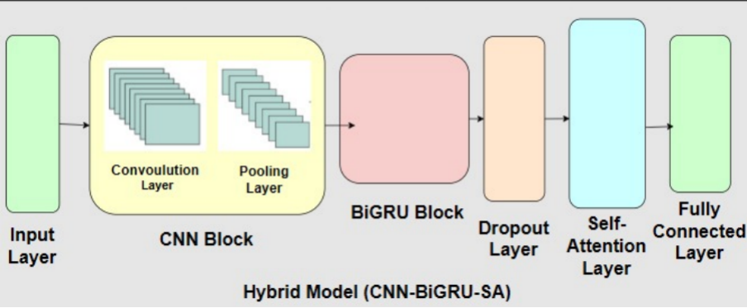
PROPOSED SYSTEM
CNN-BiGRU-SA
CNN (Convolutional Neural Network):
Extracts local temporal features and patterns from the input data.
BiGRU (Bidirectional Gated Recurrent Unit):
Captures sequential dependencies in both forward and backward directions for better temporal understanding.
Self-Attention (SA):
Highlights the most important time steps in the sequence for focused prediction.
Sustainable Energy Solutions: Predicting Residential Electricity Consumption using Deep Learning Techniques
Batch: B3

Slide 13
PROPOSED SYSTEM
Why BiGRU over BiLSTM
BiLSTM | BiGRU
Complex architecture | Simpler structure with fewer parameters
Slower training and inference | Faster convergence and runtime performance
Higher memory consumption | Lightweight - better for large datasets
Deployement complexity | Eaiser to deploy in real time applications
Sustainable Energy Solutions: Predicting Residential Electricity Consumption using Deep Learning Techniques
Batch: B3

Slide 14
DATA COLLECTION
Type of Dataset:
Time Series Dataset
Numeric (Float, Integer)
Dataset Characteristics:
No. of Records: 2,075,259 records
Time Span: December 2006 to November 2010
Sampling Rate: 1-minute intervals
Total Duration: ~4 years (47
No. of Features: 9
Associated Task:
Regression (Prediction of future electricity consumption)
Class Labels:
Date and Time, Global Active Power (kilowatts), Global Reactive Power (kilowatts), Voltage (volts), Global Intensity (amperes), Sub-metering Values (1, 2, and 3 – in watt-hours)
Sustainable Energy Solutions: Predicting Residential Electricity Consumption using Deep Learning Techniques
Batch: B3

Slide 15
DATA COLLECTION
FEATURE | DESCRIPTION
Date | Date of the measurement in dd/mm/yyyy format.
Time | Time of the measurement in hh:mm:ss format.
Global_active_power | Household global active power averaged per minute (in kilowatts).
Global_reactive_power | Reactive power averaged per minute, mainly due to inductive loads (in kilowatts).
Voltage | Average voltage during the minute (in volts).
Global_intensity | Total current drawn by the household appliances per minute (in amperes).
Sub_metering_1 | Energy usage (in watt-hours) in the kitchen
Sub_metering_2 | Energy usage (in watt-hours) in the laundry room
Sub_metering_3 | Energy usage (in watt-hours) by electric water heater and air conditioner.
Sustainable Energy Solutions: Predicting Residential Electricity Consumption using Deep Learning Techniques
Batch: B3

Slide 16
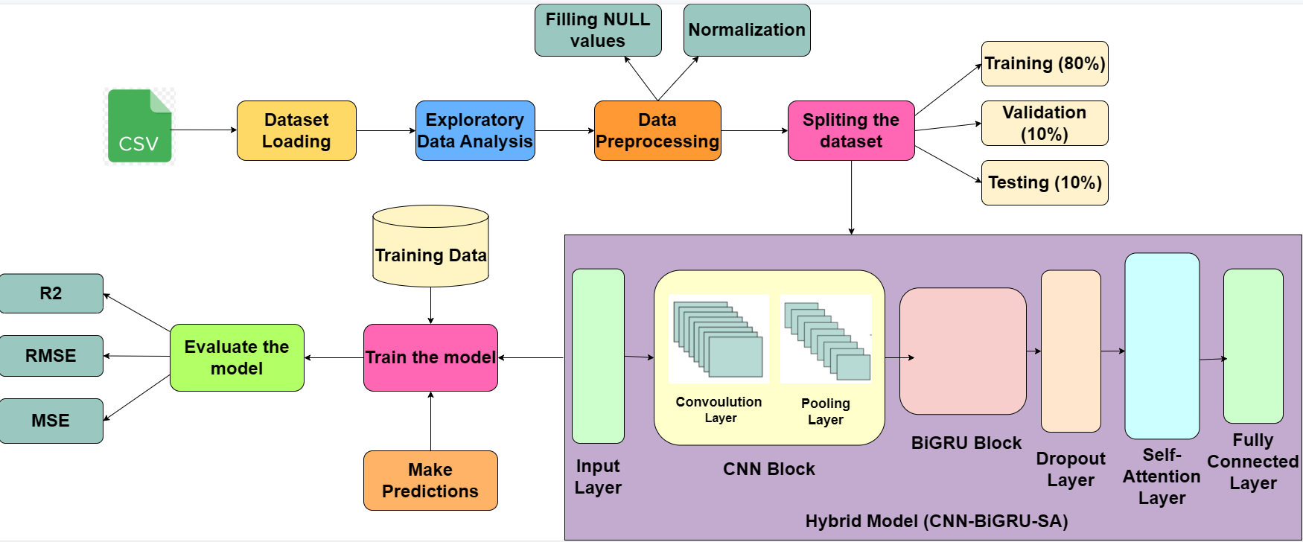
SYSTEM OVERVIEW
Sustainable Energy Solutions: Predicting Residential Electricity Consumption using Deep Learning Techniques
Batch: B3

Slide 17
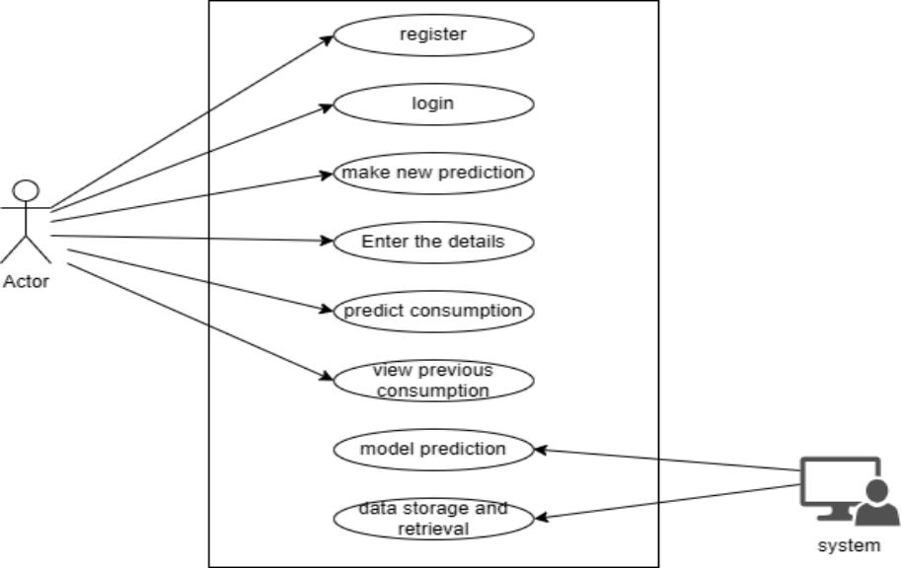
DESIGN - UML DIAGRAMS
USE CASE DIAGRAM
Sustainable Energy Solutions: Predicting Residential Electricity Consumption using Deep Learning Techniques
Batch: B3

Slide 18
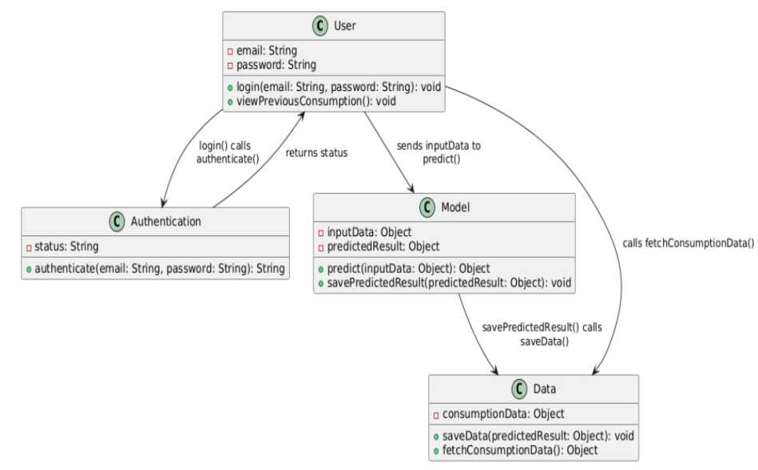
DESIGN - UML DIAGRAMS
CLASS DIAGRAM
Sustainable Energy Solutions: Predicting Residential Electricity Consumption using Deep Learning Techniques
Batch: B3

Slide 19
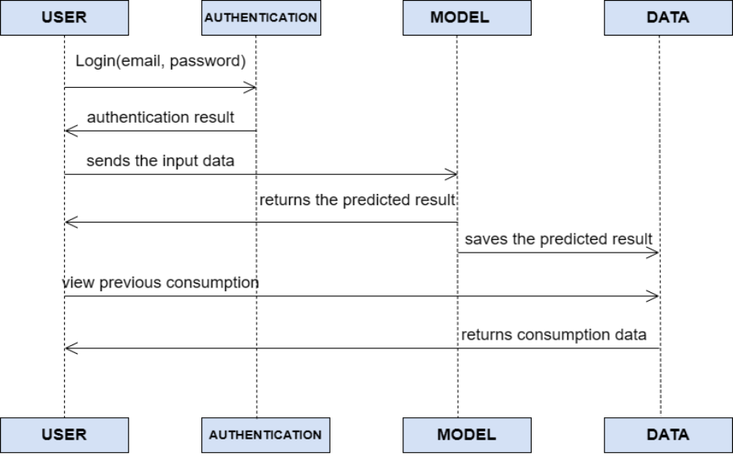
DESIGN - UML DIAGRAMS
SEQUENCE DIAGRAM
Sustainable Energy Solutions: Predicting Residential Electricity Consumption using Deep Learning Techniques
Batch: B3

Slide 20
METHODOLOGY
CNN
CNNs are specialized deep learning models designed to process data with grid-like topology, such as time series or images.
Key Layers:
Convolutional Layers (feature maps).
Pooling Layers (dimensionality reduction).
Fully Connected Layers.
Use Case: In our model, CNN is used to extract local temporal features from the input time-series data.
Sustainable Energy Solutions: Predicting Residential Electricity Consumption using Deep Learning Techniques
Batch: B3

Slide 21
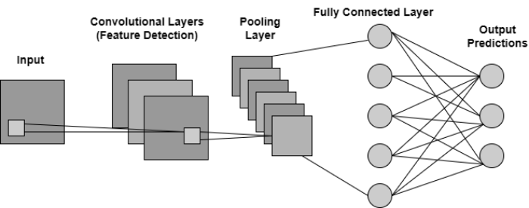
METHODOLOGY
The Structure of CNN
Sustainable Energy Solutions: Predicting Residential Electricity Consumption using Deep Learning Techniques
Batch: B3

Slide 22
METHODOLOGY
BIGRU
BiGRU is a variant of RNN that captures temporal dependencies in both forward and backward directions.
BiGRU processes sequential data bidirectionally by combining two GRUs:
Forward GRU: Processes data from past → future.
Backward GRU: Processes data from future → past.
Outputs are concatenated, capturing full contextual dependencies.
GRUs use gates to control information flow and reduce vanishing gradient issues.
In our model:
BiGRU captures long-range dependencies in the time-series data after CNN feature extraction.
Helps retain important past and future context.
Sustainable Energy Solutions: Predicting Residential Electricity Consumption using Deep Learning Techniques
Batch: B3

Slide 23
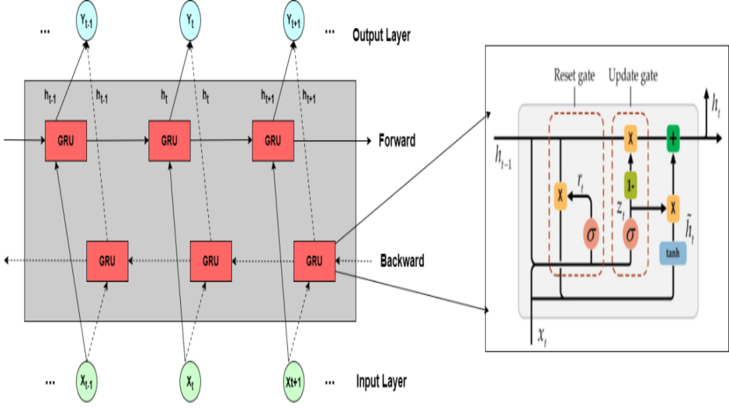
METHODOLOGY
The Structure of BiGRU
Sustainable Energy Solutions: Predicting Residential Electricity Consumption using Deep Learning Techniques
Batch: B3

Slide 24
METHODOLOGY
SELF ATTENTION
Self-Attention dynamically weighs the importance of each part of the input sequence, enabling the model to selectively focus on the most relevant features at every time step.
Key Points:
Computes attention scores by projecting input data into Query (Q), Key (K), and Value (V) vectors and determining how much focus each part deserves.
Captures long-range dependencies.
Use Case: Enhances model focus on relevant features in CNN/BiGRU outputs.
Sustainable Energy Solutions: Predicting Residential Electricity Consumption using Deep Learning Techniques
Batch: B3

Slide 25
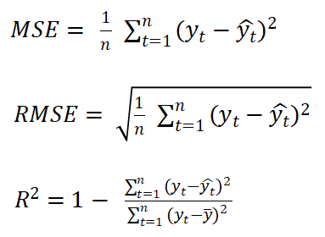
METHODOLOGY
EVALUATION METRICS
To assess the performance of our hybrid CNN-BiGRU-SA model, we use the following evaluation metrics:
Mean Squared Error (MSE):
▸Measures the average of the squared differences between actual and predicted values.
▸Penalizes larger errors, ensuring robust performance.
Root Mean Squared Error (RMSE):
▸Square root of MSE.
▸Provides error in the same unit as the target variable, aiding intuitive interpretation.
R² Score (Coefficient of Determination):
▸Indicates the proportion of variance in the actual data explained by the model.
▸A value closer to 1 shows better predictive power.
Sustainable Energy Solutions: Predicting Residential Electricity Consumption using Deep Learning Techniques
Batch: B3

Slide 26
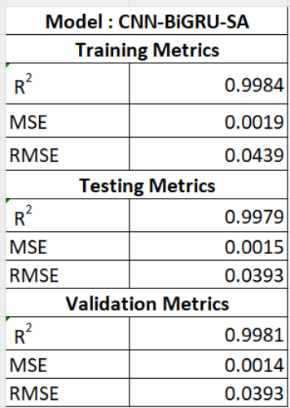
RESULT ANALYSIS
PROPOSED MODEL METRICES
Sustainable Energy Solutions: Predicting Residential Electricity Consumption using Deep Learning Techniques
Batch: B3

Slide 27
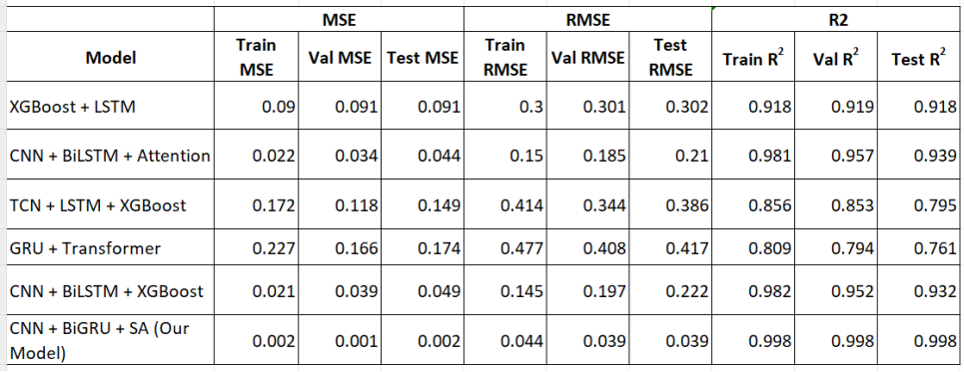
RESULT ANALYSIS
COMPARISION WITH OTHER MODELS
Sustainable Energy Solutions: Predicting Residential Electricity Consumption using Deep Learning Techniques
Batch: B3

Slide 28
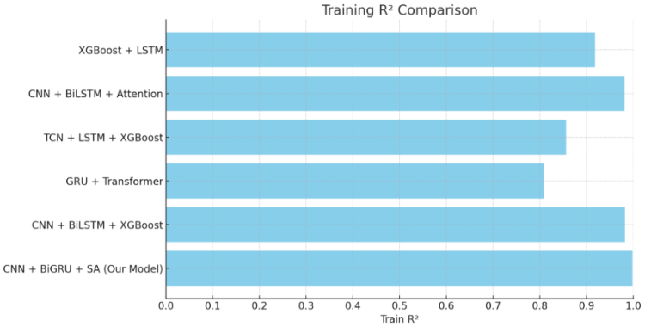
RESULT ANALYSIS
GRAPHICAL REPRESENTATION OF COMPARISION
Sustainable Energy Solutions: Predicting Residential Electricity Consumption using Deep Learning Techniques
Batch: B3

Slide 29
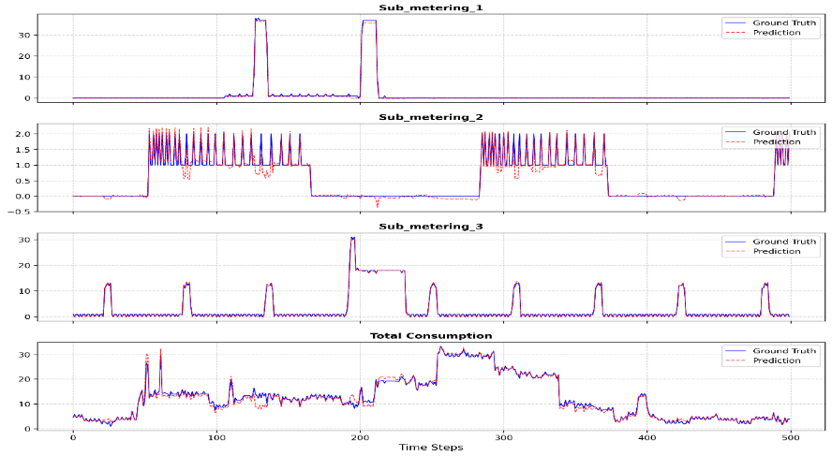
RESULT ANALYSIS
ACTUAL VS PREDICTED VALUE
Sustainable Energy Solutions: Predicting Residential Electricity Consumption using Deep Learning Techniques
Batch: B3

Slide 30
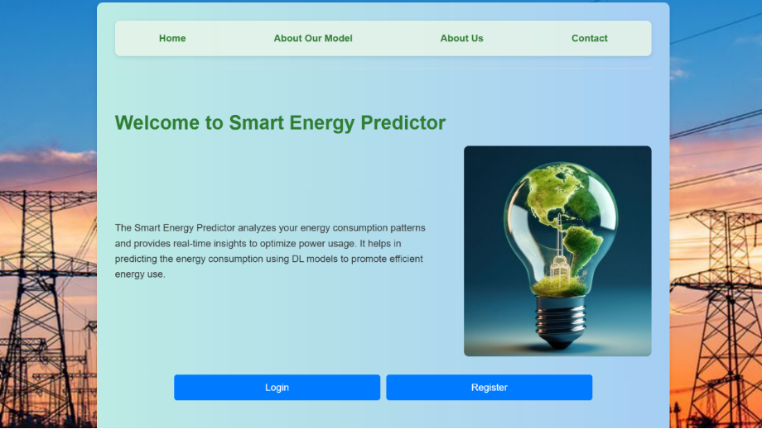
OUTPUT SCREENS
Sustainable Energy Solutions: Predicting Residential Electricity Consumption using Deep Learning Techniques
Batch: B3

Slide 31
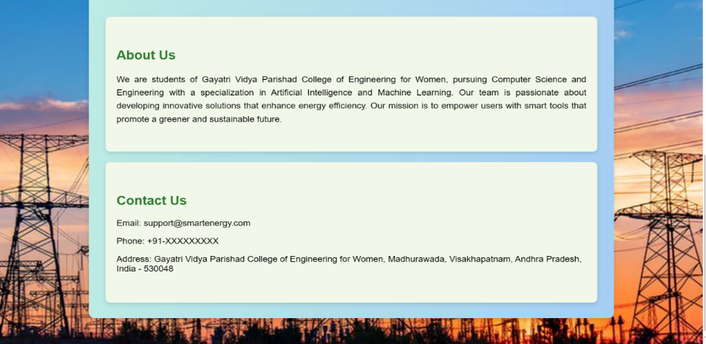
OUTPUT SCREENS
Sustainable Energy Solutions: Predicting Residential Electricity Consumption using Deep Learning Techniques
Batch: B3

Slide 32
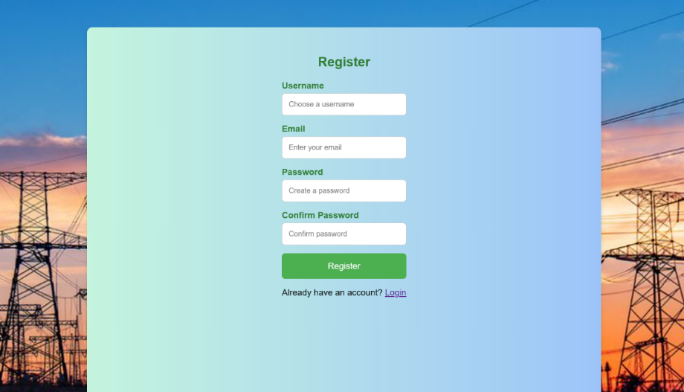

OUTPUT SCREENS
Sustainable Energy Solutions: Predicting Residential Electricity Consumption using Deep Learning Techniques
Batch: B3

Slide 33
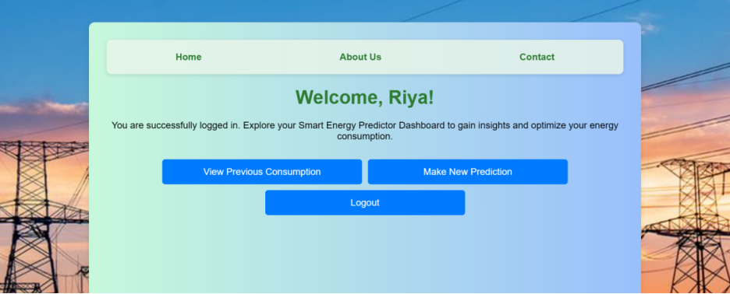
OUTPUT SCREENS
Sustainable Energy Solutions: Predicting Residential Electricity Consumption using Deep Learning Techniques
Batch: B3

Slide 34
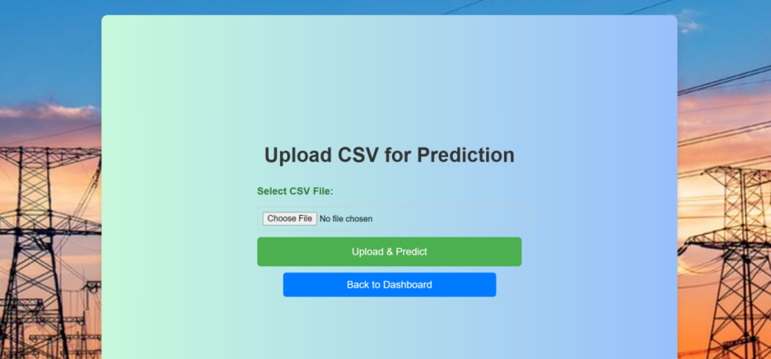
OUTPUT SCREENS
Sustainable Energy Solutions: Predicting Residential Electricity Consumption using Deep Learning Techniques
Batch: B3

Slide 35
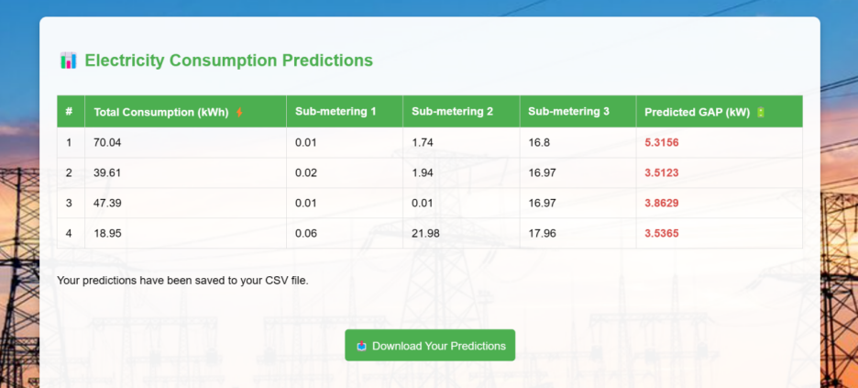
OUTPUT SCREENS
Sustainable Energy Solutions: Predicting Residential Electricity Consumption using Deep Learning Techniques

Slide 36
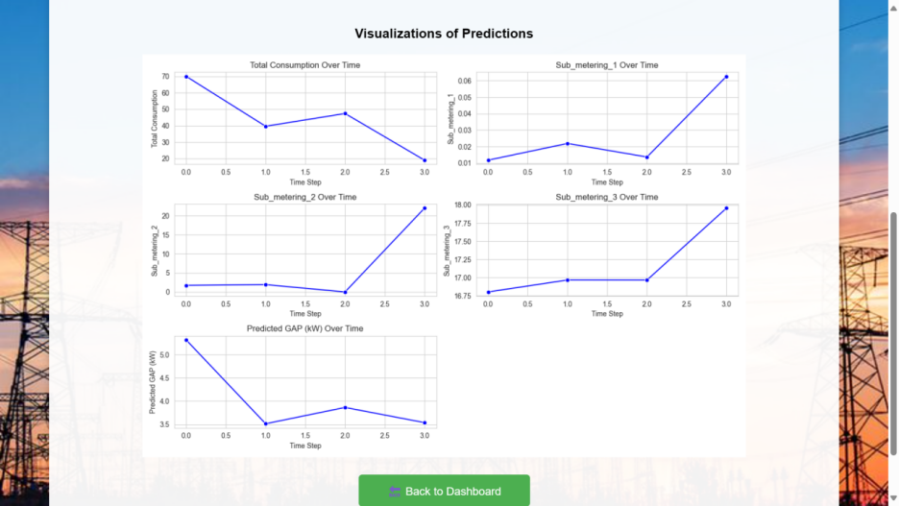
Batch: B3
OUTPUT SCREENS
Sustainable Energy Solutions: Predicting Residential Electricity Consumption using Deep Learning Techniques
Batch: B3

Slide 37
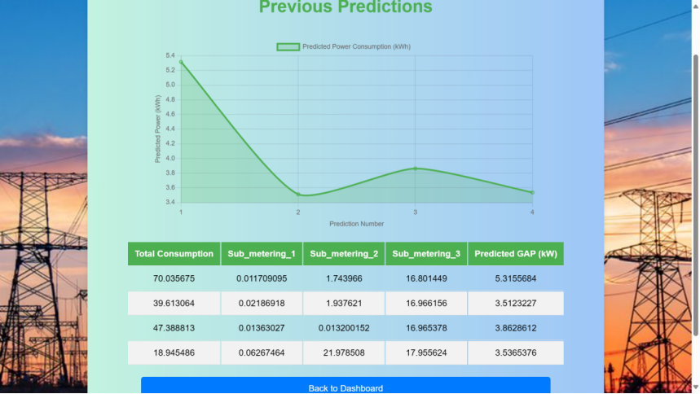
Batch: B3
OUTPUT SCREENS
Sustainable Energy Solutions: Predicting Residential Electricity Consumption using Deep Learning Techniques
Batch: B3

Slide 38
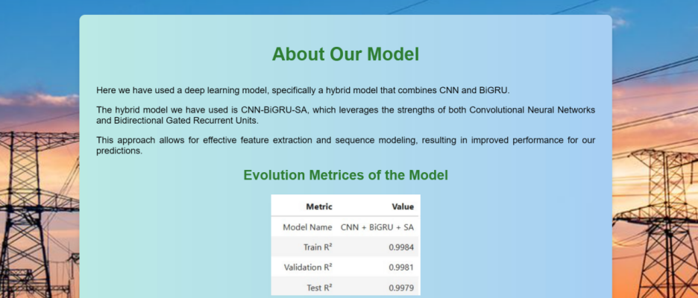
Batch: B3
OUTPUT SCREENS
Sustainable Energy Solutions: Predicting Residential Electricity Consumption using Deep Learning Techniques
Batch: B3

Slide 39
CONCLUSION
The Residential Electricity Prediction System was successfully developed using a hybrid CNN-BiGRU-SA model to predict electricity consumption with high accuracy.
The model efficiently extracts temporal and contextual patterns from time-series data using CNN, BiGRU, and a Self-Attention mechanism.
A Flask-based frontend offers an intuitive interface for data input, prediction visualization, and actionable insights.
The system meets both functional and non-functional requirements, proving to be a robust and reliable tool for forecasting residential electricity usage.
Comprehensive testing and validation confirm its readiness for real-world deployment.
Sustainable Energy Solutions: Predicting Residential Electricity Consumption using Deep Learning Techniques
Batch: B3

Slide 40
FUTURE SCOPE
To further enhance the Residential Electricity Prediction System, future improvements can focus on integrating a real-time energy monitoring dashboard, enabling users to visualize live electricity consumption trends and generate real-time alerts for abnormal usage patterns. This enhancement can be achieved by incorporating IoT devices such as smart meters, which can automate data collection and continuously feed real-time information into the system. By leveraging IoT devices for real-time data acquisition, the system can dynamically analyze consumption patterns, detect anomalies, and notify users about any irregularities. This feature will empower users to take timely actions to optimize energy consumption and reduce unnecessary power usage. These improvements will transform the system into a more intelligent and proactive solution, providing users with real-time insights and greater control over their energy consumption.
Sustainable Energy Solutions: Predicting Residential Electricity Consumption using Deep Learning Techniques
Batch: B3

Slide 41
REFERENCES
[1] Alhussein, M., et al., "Hybrid CNN-LSTM Model for Short-Term Individual Household Load Forecasting," IEEE Access, vol. 8, 2020.
[2] Hyeon, J., et al., "Deep Learning-Based Household Electric Energy Consumption Forecasting," Journal of Engineering, J. Eng., 2020, Vol. 2020 Iss. 13, pp. 639-642.
[3] Aurangzeb, M., et al., "Short Term Power Load Forecasting Using Machine Learning Models," Proceedings of the International Conference on Computer and Information Sciences, 2019.
[4] Hajjaji, M., et al., "Evaluation of Artificial Intelligence Algorithms for Predicting Power Consumption," Proceedings of the International Wireless Communications and Mobile Computing Conference, IEEE Access, 2021, pp. 2121-2126
Sustainable Energy Solutions: Predicting Residential Electricity Consumption using Deep Learning Techniques
Batch: B3

Slide 42
THANK YOU
Sustainable Energy Solutions: Predicting Residential Electricity Consumption using Deep Learning Techniques
Batch: B3

